Slide 1

GROTON DUNSTABLE REGIONAL HIGH SCHOOL
POTABLE WATER SUPPLY SOLUTIONS

Slide 2
BACKGROUND
In 2022, the Groton Dunstable Regional High School (GDRHS) sampled for PFAS6 in the schools well. Results came in well above the Maximum Containment Level enforced by MassDEP.
  The cause of the contamination was a 2003 fire on the athletic field track that was extinguished with Aqueous Film Forming Foam (AFFF), a known PFAS contamination contributor.
MassDEP has also sampled the surrounding private wells along Groton Street and Kemp Street. Several have high levels of PFAS6.
  MassDEP notified the GDRHS that they are responsible for the PFAS6 contamination and must provide a solution to all impacted residents.

Slide 3
ALTERNATIVE WATER SUPPLY OPTIONS
Representatives from the School District and Towns of Groton, Dunstable, and Pepperell met several times to evaluate all the feasible options.
Goal: Provide PFAS-free water to GDRHS and impacted private properties
Two primary water main alternatives were evaluated for final consideration.
  Alternative I – Extend the Dunstable Water System 7.1 miles to provide interconnection with Pepperell and service the GDRHS and the PFAS-impacted properties.
  Alternative II – Extend the Groton Water System 6.4 miles to service the GDRHS and the PFAS-impacted properties.

Slide 4
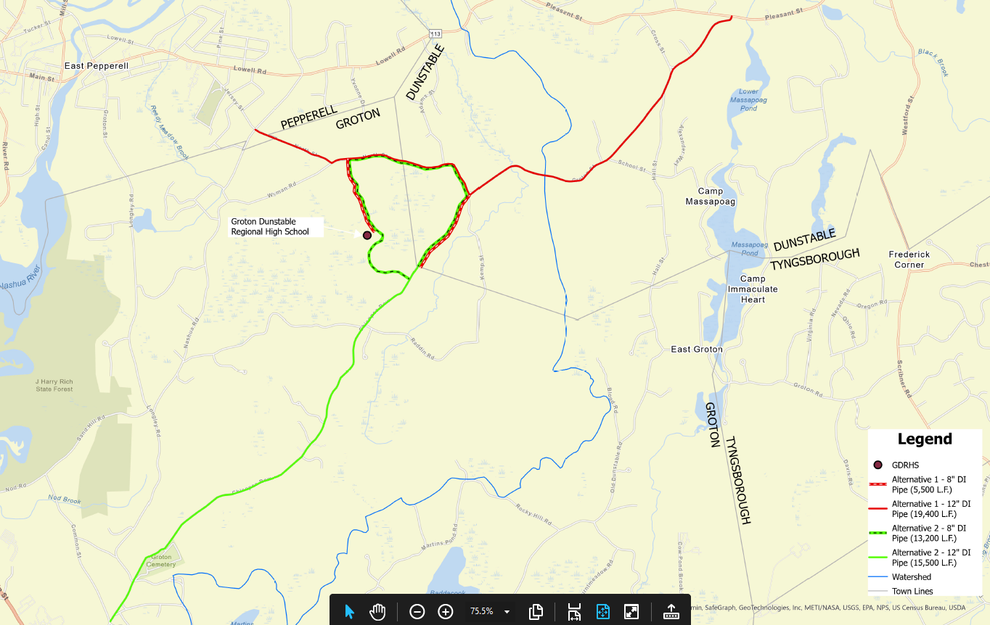
ALTERNATIVE I
GDRHS
ALTERNATIVE II

Slide 5
COMPARABLE CAPITAL COSTS
SIMILAR FOR BOTH ALTERNATIVES (+/-5%)
 | ALTERNATIVE I | ALTERNATIVE II
 | Dunstable - Pepperell Water System Expansion | Groton Water System Expansion
COMPARABLE CAPITAL COST (Planning Level) | $17,630,000 | $16,780,000
PEPPERELL PORTION | -$10,400,000 | -
DUNSTABLE PORTION | -$1,660,000 | -$3,860,000
REMAINING (GROTON) | $5,570,000 | $12,920,000
GROTON 30-YEAR LOAN MONTHLY PAYMENT (DWSRF, 0% interest, Begins FY27) | $15,500 | $36,000
Notes:
15% Engineering
20% Contingency (+10-20% in line items)
Discuss the 77% / 23% cost split between Groton & Dunstable – already included in these numbers

Slide 6
SCHEDULE & PERMITTING
 | ALTERNATIVE I | ALTERNATIVE II
 | Dunstable - Pepperell Water System Expansion | Groton Water System Expansion
ENGINEERING & PERMITTING | 1-3 years | 1-2 years
CONSTRUCTION | 1-year | 1-year
TOTAL | 2-4 years | 1.5-3 years
Notes:
NOTES
Both: Engineering Timeline can be shortened if funded and authorized in advance of construction appropriation.
I: ENF, DEP WS, Interbasin Transfer and Water Management Act Permits required. Permitting could be shortened if project is broken into Phases.
II: ENF, DEP WS, and Interbasin Transfer Permits required.

Slide 7
ALTERNATIVE I (Dunstable-Pepperell Interconnection)
Advantages | Disadvantages
Less capital cost for Groton | Little fire protection and water system infrastructure benefit for Groton beyond the GDRHS
No additional water system operations & maintenance for the Groton Water Department | No new water customers for the Groton Water System
May provide irrigation water (with additional cost) sooner than Alternative II via connection to Pepperell and temporary treatment facility | Groton Dunstable School District subject to Dunstable/Pepperell water rates, potentially including cost for new treatment facilities for PFAS
 | Potential for longer permitting timeline and more requirements than Alternative II (TBD)

Slide 8
ALTERNATIVE II (Groton Water System Extension)
Advantages | Disadvantages
Expands municipal fire protection and water service to Groton residents | More expensive option for Groton
Potential for 136 new water system customers | Additional water system operations & maintenance for the Groton Water Department
Potential for less significant permit restrictions than Alternative I (TBD)
Cost control rests with Groton

Slide 9
NEXT STEPS
Alternatives are subject to approval from MassDEP and the Water Resources Commission
Town Meeting approval for funding
Costs to be refined during design phase
Details needed for inter-municipal agreements to determine capital cost sharing and water usage rates

Slide 10
Questions?

